Slide 1
Presentation 1
Phase I: Machine Learning
Alireza Toghyiani - 20/01/2022

Slide 2
Cleaning Data
Handling incomplete or missing data
Handling invalid data
Handling outliers data
Handling duplicate or inconsistent data

Slide 3
Handling Incomplete/Missing Data
Preserve data points
Find accurate values for missing data
Guess/Estimate missing values
Use data in similar rows
Ignore missing data
Drop the column(s) with most missing values
Drop the rows containing missing data

Slide 4
Handling Invalid Data
Data-Type Constraints
Range Constraints
Unique Constraints
Regular expression patterns
Inconsistent/Duplicate Data

Slide 5
Handling Outliers Data

Slide 6
Handling Outliers Data
What is Outlier data?
An outlier is an observation that lies an abnormal distance from other values in a random sample from a population.
How find them?
Visualization using scatterplot or box-plot
Statistical analyzing data
Z-score

Slide 7
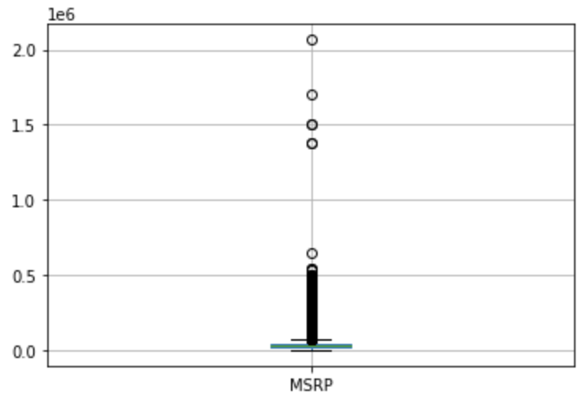
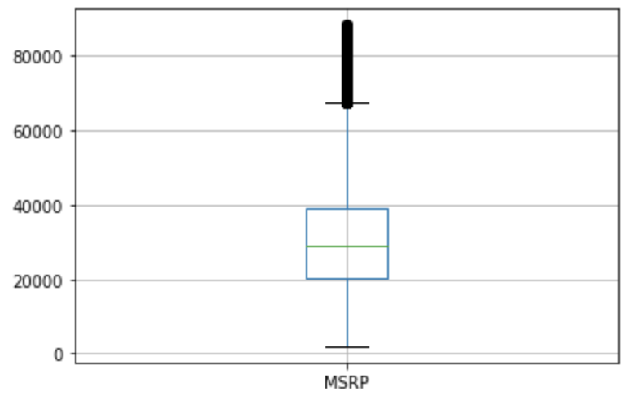
Handling Outliers Data

Slide 8
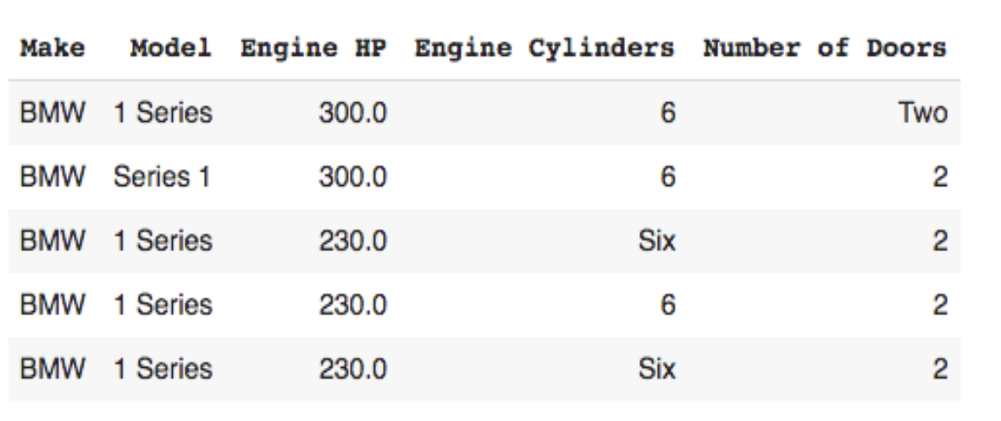
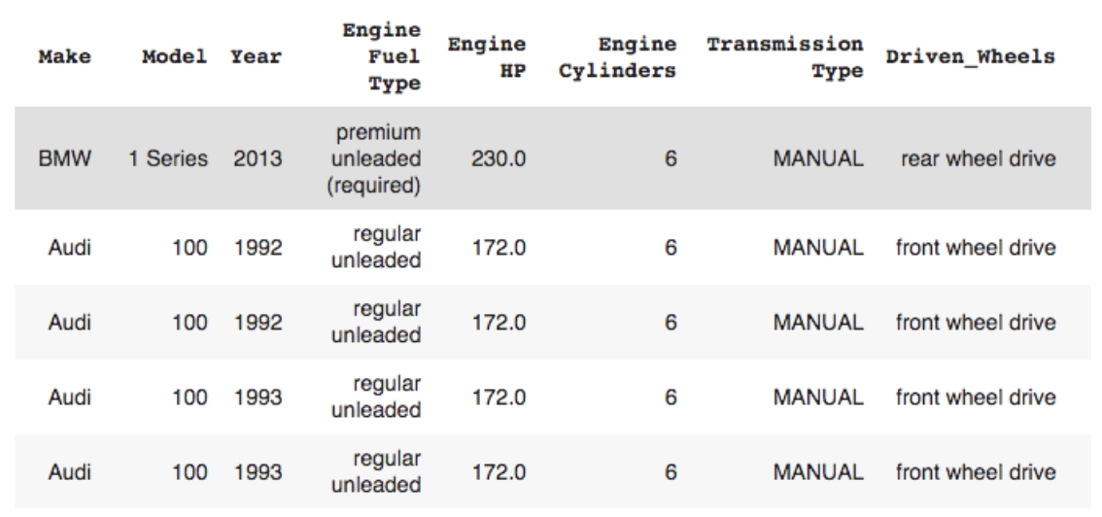
Handling Duplicate/Inconsistent Data

Slide 9
Pre-Processing Data

Slide 10
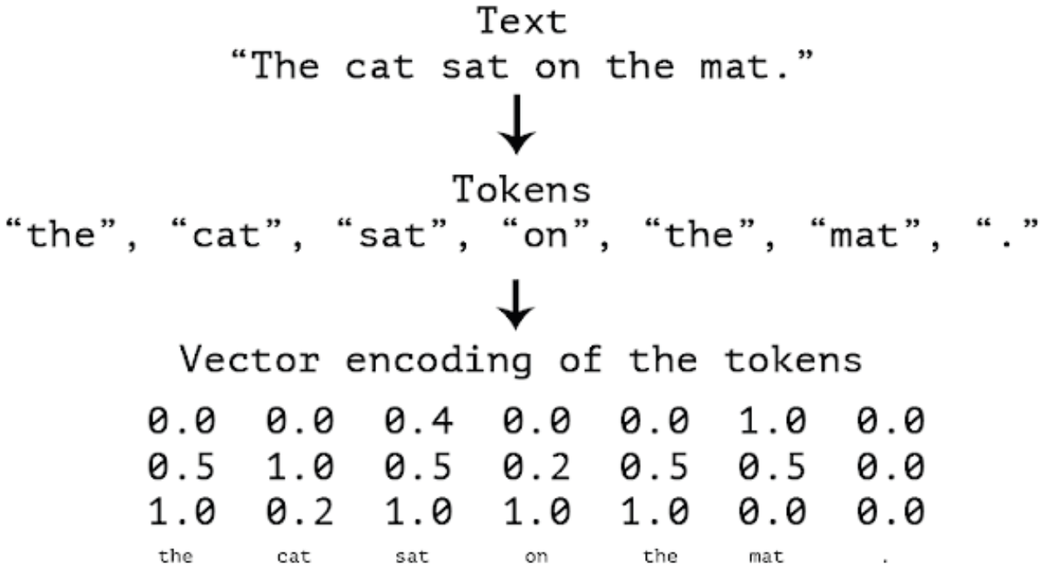
Convert to Numerical Values
Convert “categorical” variables to numbers
Transform Boolean values to 0/1
Embedding text into vectors

Slide 11
Handling Categorical Data

Slide 12
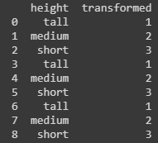

Categorical Encoding
This type of encoding is used when the variables in the data are ordinal, ordinal encoding converts each label into integer values and the encoded data represents the sequence of labels.

Slide 13

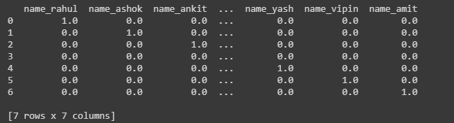
One-Hot Encoding
Each category of any categorical variable gets a new variable. It maps each category with binary numbers (0 or 1). This type of encoding is used when the data is nominal.

Slide 14
Normalization
We need to make sure that all columns have a "similar" range.
There are several ways of accomplishing this step. Two of the most popular options are:
SatandardScaler: converts the data in a column so that it has a 0-mean and standard deviation of 1.
MinMaxScaler: simply scales the data in a column so that maximum value is 1 and the minimum value is 0.
Other scaling methods are also available.

Slide 15
Correlation Analysis
Identify columns that behave very similarly and drop all but one of them.
Ensures that we do not over-emphasize similar features.

Slide 16
Feature Selection
Remove unnecessary data
Improved Accuracy
Prevent learning model from noise(Overfitting)

Slide 17
Feature Selection Methods
Filter Method
Drop based on their relation or how they are correlating to the output
Wrapper Method
Split data into subsets and train a model using this, based on the output of the model add and subtract the features again.

Slide 18
Feature Selection Methods
Some of the common feature selection methods:
Lasso Regularization
Chi Squared
Genetic Algorithms
Pearson’s Coefficient
ANOVA Coefficient
Recursive feature elimination
Decision Trees

Slide 19
Exploratory Data Analysis (EDA)
In essence, EDA mean to get to know your data and the problem better by:
Summarizing it
Visualizing it
Looking for patterns
& …
A great part of EDA is to get more familiar with our data, check for any obvious patterns and get inspired on what we can do with the data.

Slide 20
Colab Link

Slide 21
Q & A

Slide 22
The End

